Slide 1
ANDROID PROJECT PHONEBOOK
ZHU ZHIRU

Slide 2
1
BRIEF INTRODUCTION

Slide 3
Basic Features
1
2
3
4
Contacts and
Records
Display of
Records
Display of
Contacts
Special Day Reminder

Slide 4
Extra Features
Special means to add contacts
Support to scan business card or QR code to add a contact
No disturbing mode
Support to block non-whitelist numbers within a specified peroid of time

Slide 5
2
BRIEF CONTENTS

Slide 6
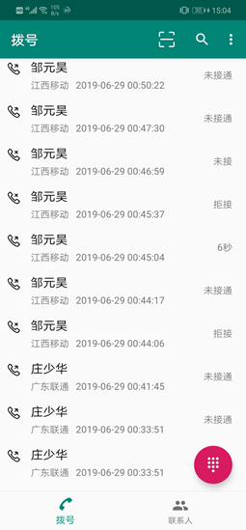
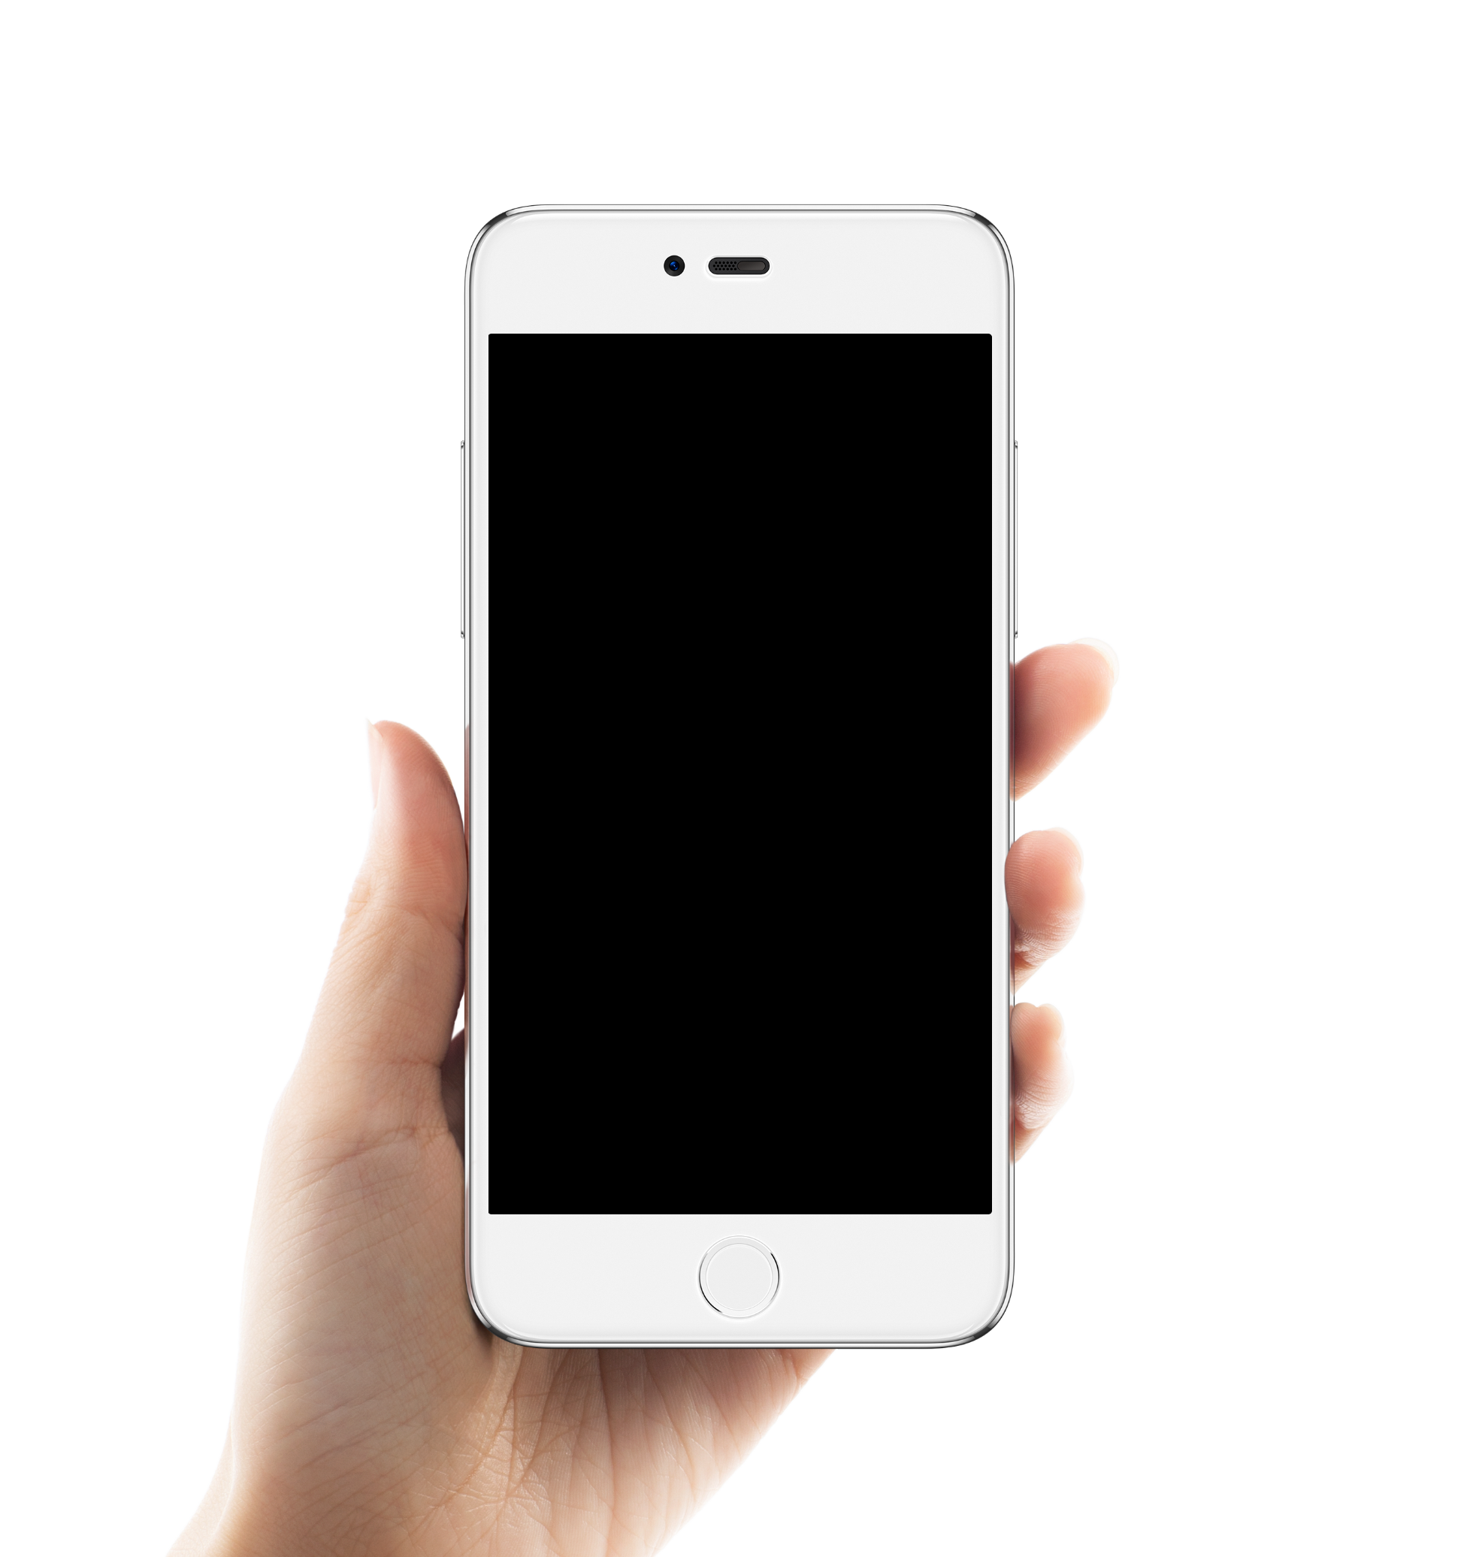
Call Record Interface
Display call records.
Click a record and app will call the corresponding phone.

Slide 7
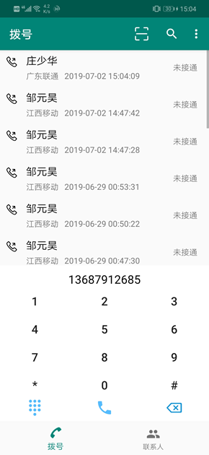
Dial Interface
Click the number on the dial to make a call. If the input number is empty, click the dial key and app will show the last number you have called.
Click the button in the lower left corner of the dial to hide the dial interface.

Slide 8
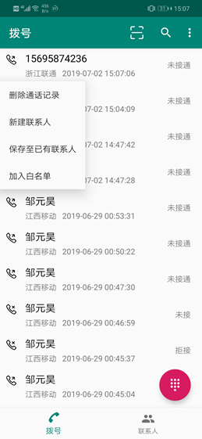
Small Menu of Records
Long press a record and app will pop up a menu.
Click the menu option and app will appear the corresponding features.

Slide 9
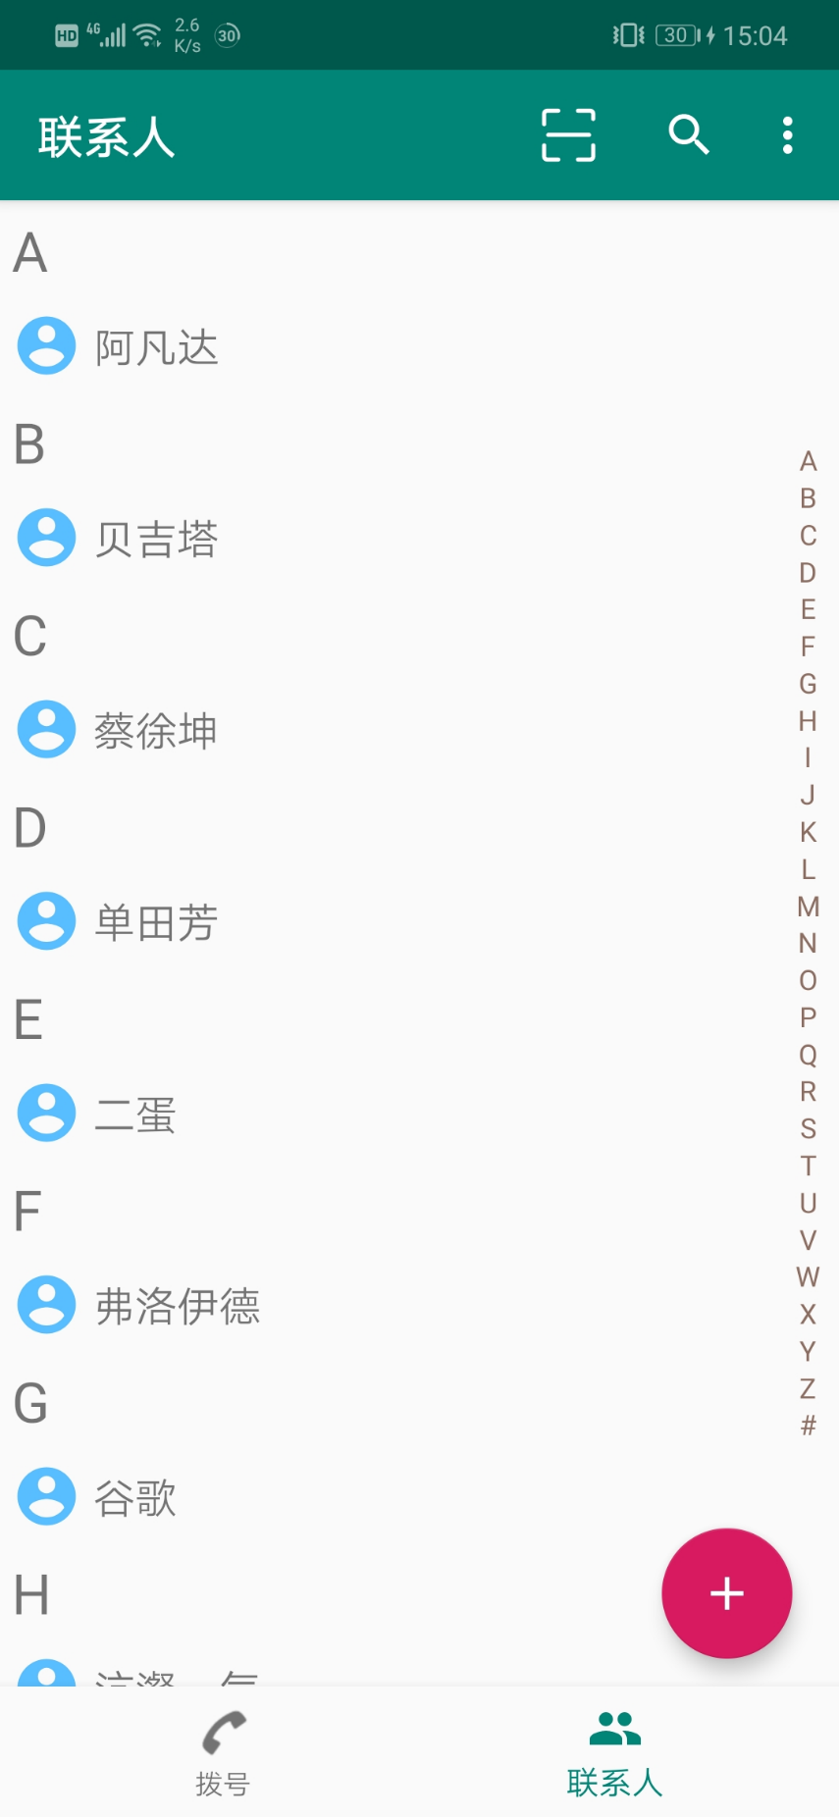
Contact Interface
Click the "Contacts" navigation bar at the bottom of the image to display the saved contacts.
Click the "Contacts" to enter the contact detail interface.
Click the scan button in the upper right corner of the toolbar and the scan interface will appear.
Click the search button and the search interface will appear.

Slide 10
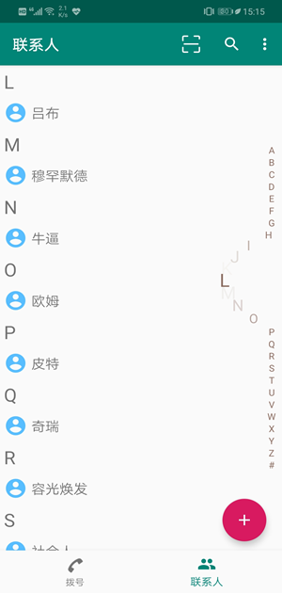
Contact Sliding Interface
Swipe the list of initials on the right to display the contacts corresponding to the pinyin initials.

Slide 11
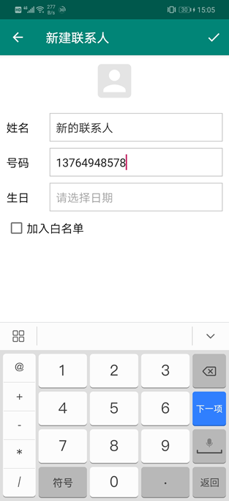
New Contact Interface
Fill in the corresponding information to add a contact.

Slide 12
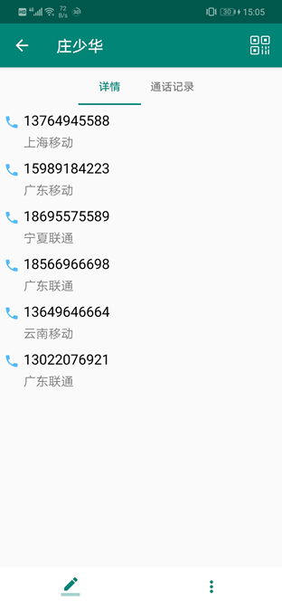
Contact Detail Interface
Click a contact and app will display contact detail interface.
Click a phone number and app will call it.

Slide 13
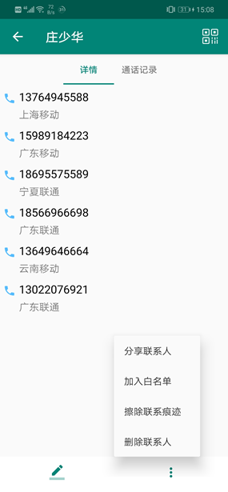
Contact Toolbar Button
Click the toolbar to display the menu
Click the menu options to show the corresponding features

Slide 14
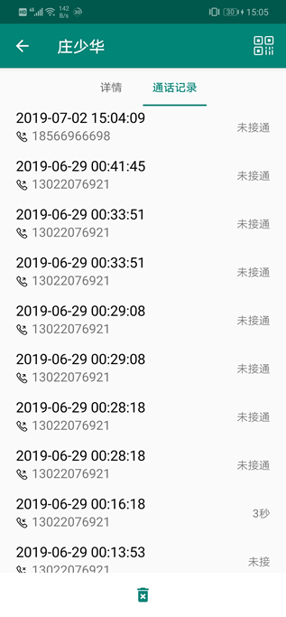
Contact Record Interface
Swipe right to enter the contact record interface.
Swipe left to enter the contact detail interface.
Click a call record to dial the corresponding number.
Long press a record, app will prompt whether to delete the record.
Click the delete button, app will prompt whether to delete all the call records.

Slide 15
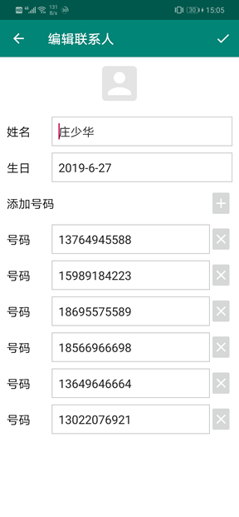
Contact Editing Interface
Click the editing button to show the contact editing interface.
Modify the contact information and add or delete the contact number in below.

Slide 16
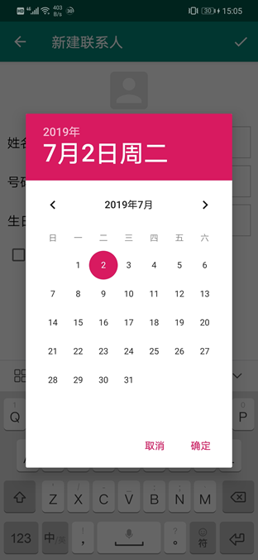
Contact Birthday Selection Interface
Select the birthday of the contact.

Slide 17
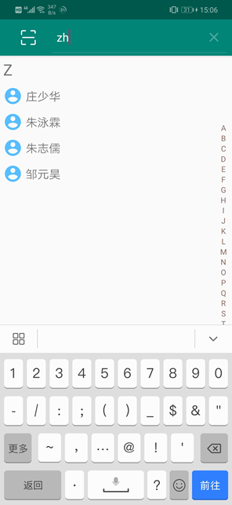
Contact Global Search Feature
Click the search button in the upper right corner.
Enter the first letter of the contact to search the corresponding contact.

Slide 18
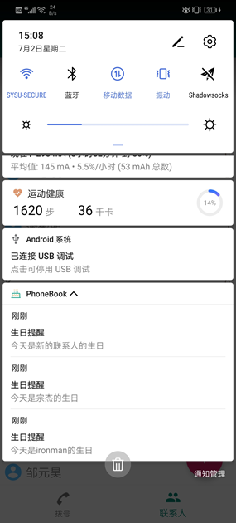
Birthday Reminder Feature
This feature is enabled by default.
Every time the app is started, birthday and important holiday reminders of contacts will appear.
You can turn this feature off in the "More" button in the upper right corner.

Slide 19
3
QR Code Generation & scanner
EXTEND CONTENT

Slide 20
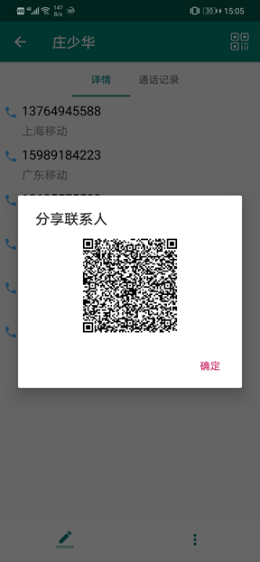
Contact Sharing Interface (QR Code)
Click the QR code button in the upper right corner or the "Share Contact" option in the toolbar.
The QR code for sharing this contact will appear.

Slide 21
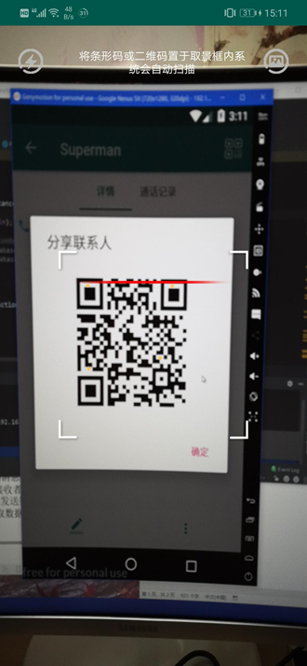
Contact Sharing Interface (QR Code)
Click the scan button to enter the scanning interface. You can scan the QR code to add contacts

Slide 22
4
No Disturbing
EXTEND CONTENT

Slide 23
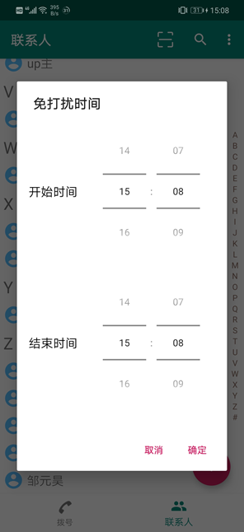
No Disturbing Time Selection Interface
Click the "More" button in the upper right corner to turn on the “No Disturbing" feature.
Slide the time wheel to select the "No Disturbing" time.
During this period, the app will automatically intercept non-whitelist calls.

Slide 24
THANKS FOR YOUR WATCHING
2021-5-17

